Slide 1
PAPER AND PULP
-2022
Chemistry in service of mankind
Here is where our presentation begins

Slide 2
TABLE OF CONTENTS
01
03
Introduction
Sources
02
Raw materials
-2022
You can describe the topic of the section here
You can describe the topic of the section here
Chemistry
You can describe the topic of the section here

Slide 3
01
Introduction
-2022
A quick intro to paper and pulp
Paper and pulp

Slide 4
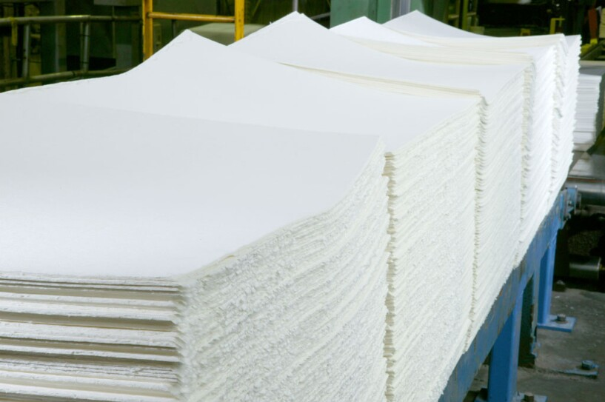
Paper and Pulp
-2022
Paper pulp or pulp is a fibrous material that is made from plant fiber with different pulp processing. The major ingredient of pulp includes cellulose, hemicellulose, lignin, pigment, resin, pectin, and ash, etc.
Pulp is a primary material that is used to make paper.
Paper and pulp

Slide 5
02
Sources of Raw materials
-2022
The raw materials used for paper and pulp
Paper and pulp

Slide 6
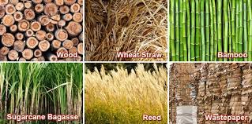
Sources of Raw materials
-2022
The basic raw material of paper is cellulose in the form of fiber. Cellulose fiber occurs in many vegetable tissues, from which it can readily be extracted by mechanical or chemical means.
Agricultural wastes—straw, corn stalks, bagasse (sugarcane waste), bamboo, and some other grasses—are used for making certain grades. Finally, one of the most important sources of pulp is the fiber recovered from old papers, rags, and cardboard boxes.
Finally, one of the most important sources of pulp is the fiber recovered from old papers, rags, and cardboard boxes.
Paper and pulp

Slide 7
03
Raw materials
-2022
Types of raw materials
Paper and pulp

Slide 8
Raw materials
-2022
There are two types of raw materials for paper and pulp. They are:
1. Fibrous Raw Materials
Paper pulp: ground wood, bleached and unbleached pulp, semi-chemical pulp.
Reuse pulp: Paper products, newspaper, paper bound.
Cellulose pulp: Straw, linen, cotton.
Specialty pulp: Inorganic fibers such as asbestos and glass.
2. Non-Fibrous Raw Materials
The materials which are used for filtering, sizing and coating of paper are included in such raw materials. These chemicals are used for pulping and bleaching.
Some of them are: clay, Talc, TiO_{2,} ZnS, CaCo₃, alums, Sulphur lime etc.
Paper and pulp

Slide 9
THANK YOU
VERY MUCH!
DO YOU HAVE ANY QUESTIONS?
PREPARED BY
BUDDHA ALE
SUMAN THAPA
KRITAGYA THAPA
UJJWAL KHAKDA
RIJAN RAI

